Slide 1
Sheikh Hasina University, Netrokona
Department of Computer Science and Engineering
CSE-2205: Introduction to Mechatronics
Lec-23: Programmable Logic Controller (PLC)
Mechatronics: Electronic Control Systems in Mechanical Engineering by W. Bolton
Md. Ariful Islam
Assistant Professor
Dept. of Robotics and Mechatronics Engineering
University of Dhaka
&
Adjunct Faculty
Sheikh Hasina University, Netrokona
Department of Computer Science and Engineering

Slide 11
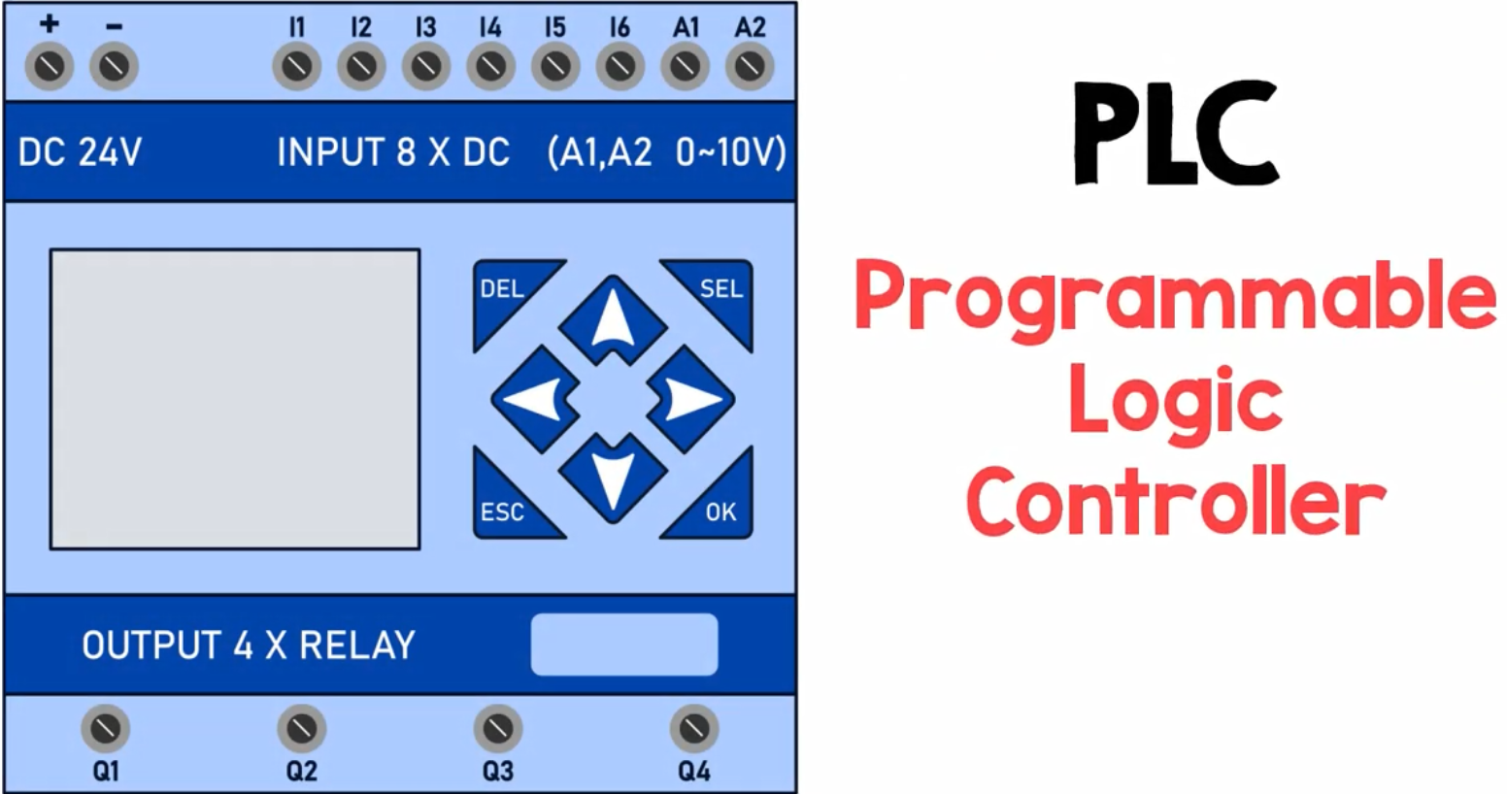

Slide 12
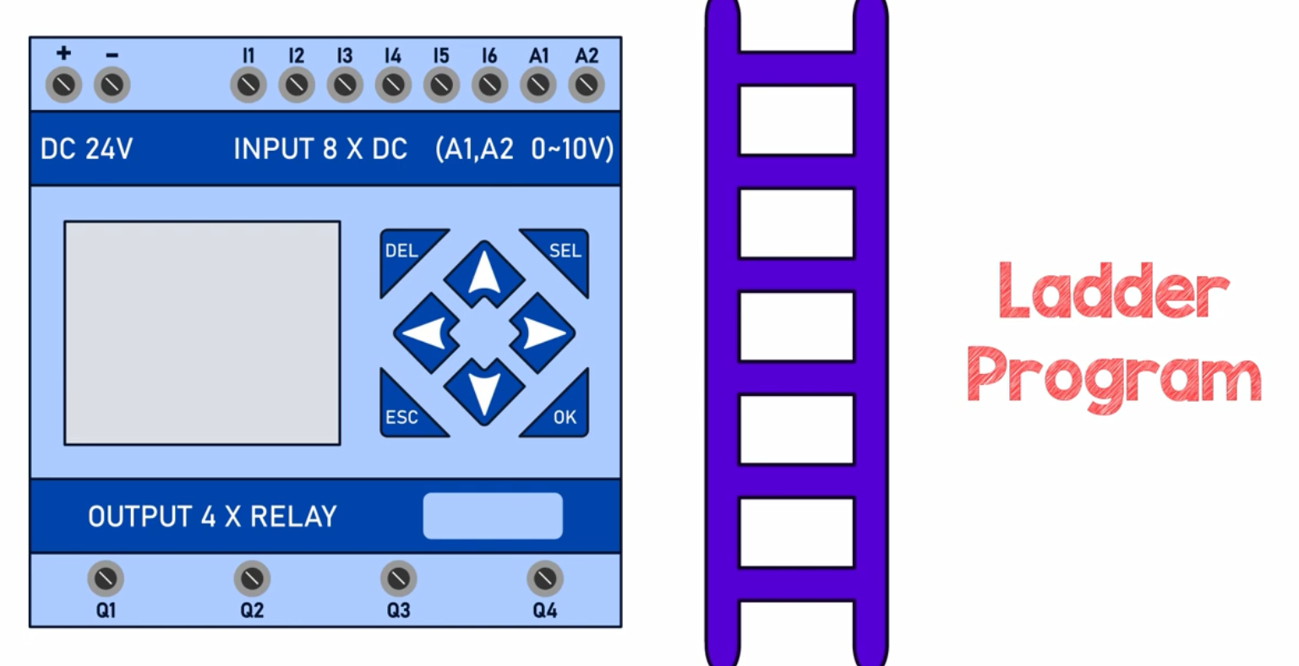

Slide 13
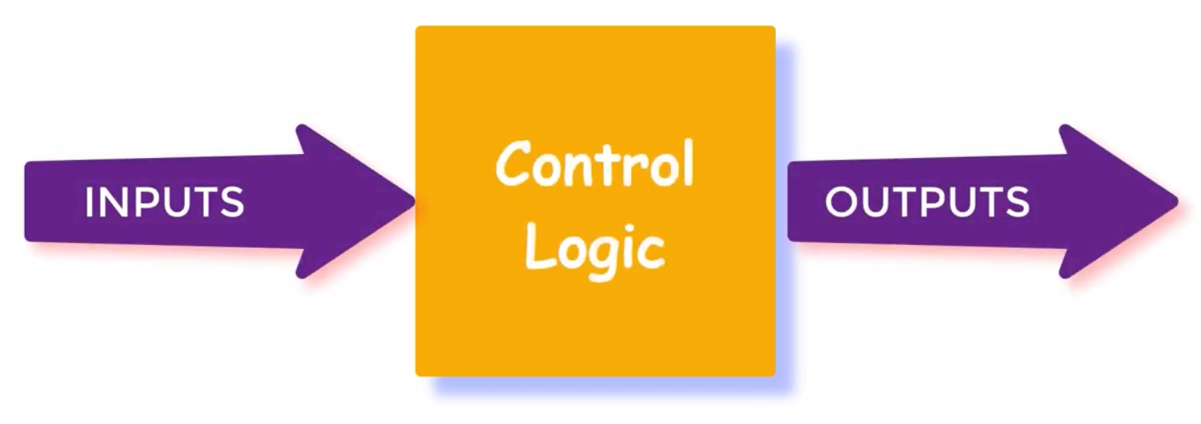

Slide 14
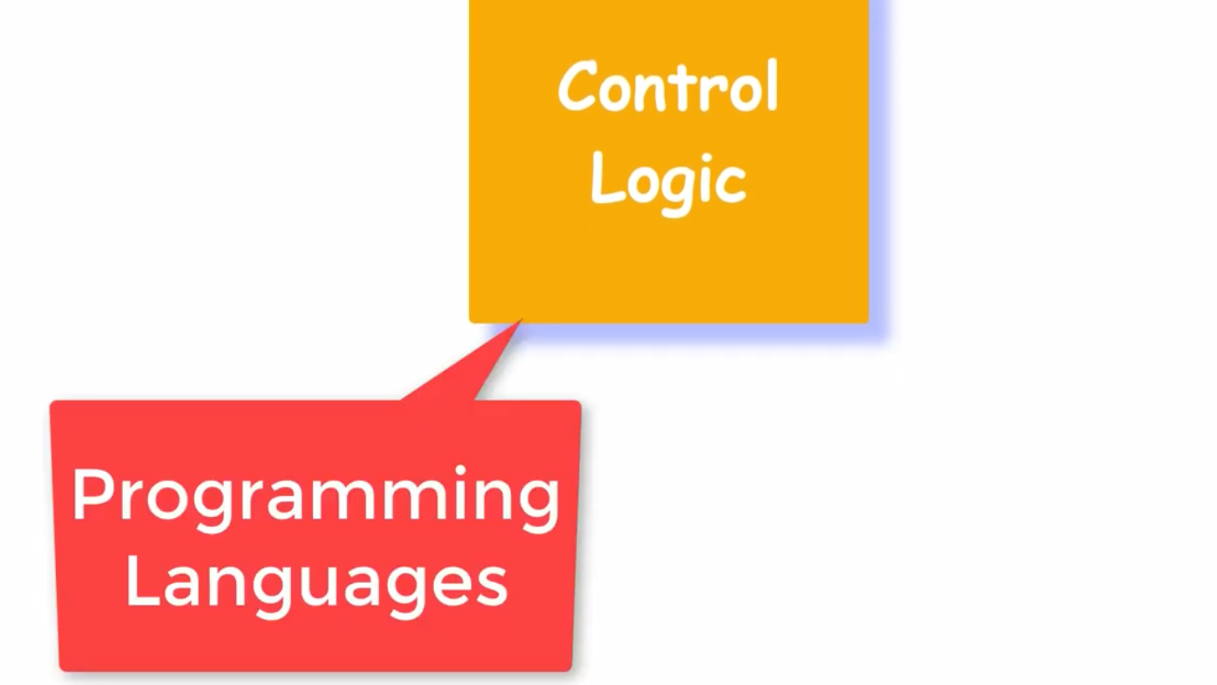

Slide 15
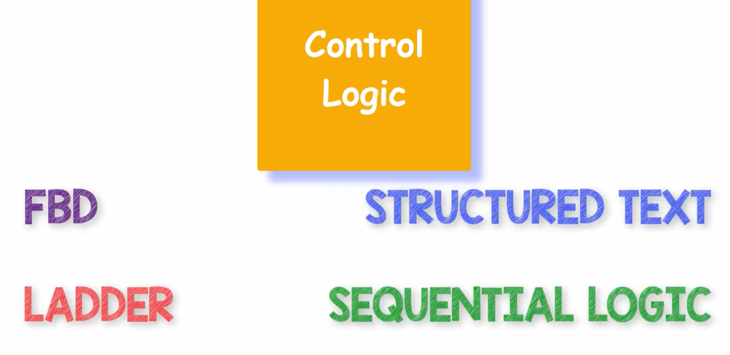

Slide 16
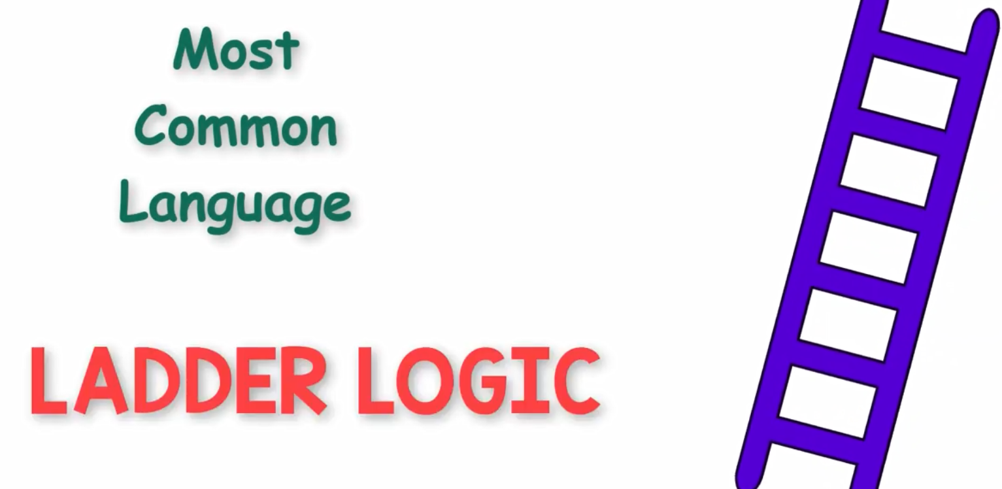

Slide 17
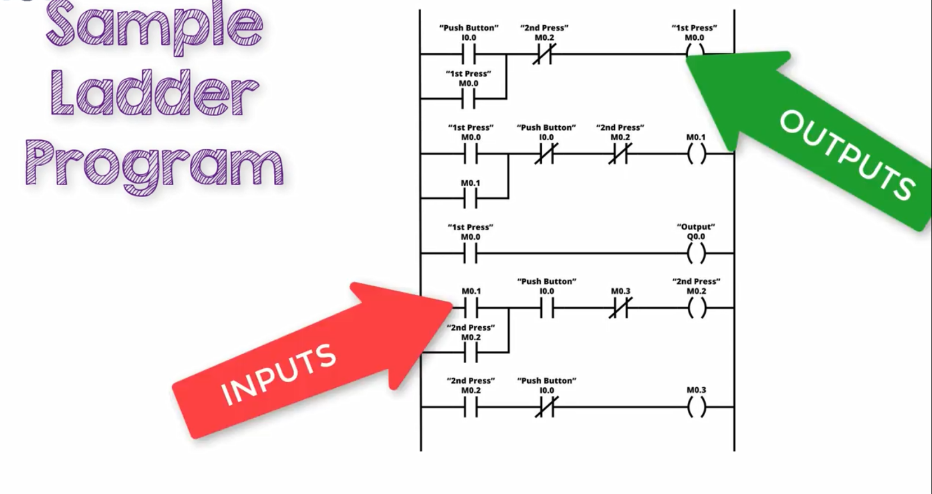

Slide 18
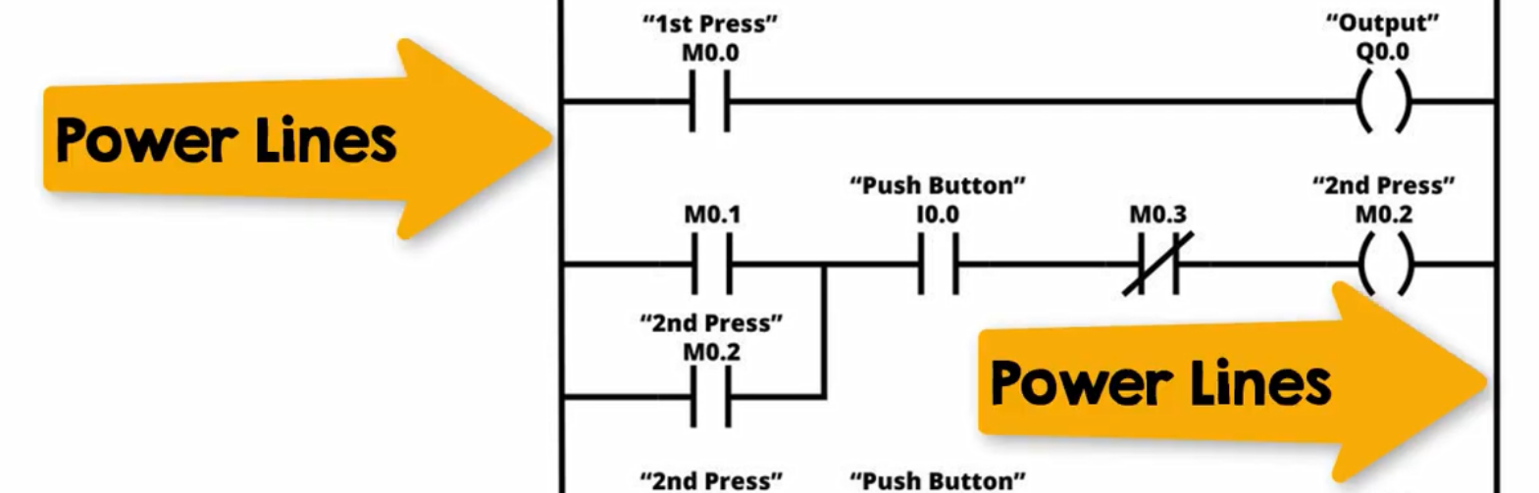

Slide 19
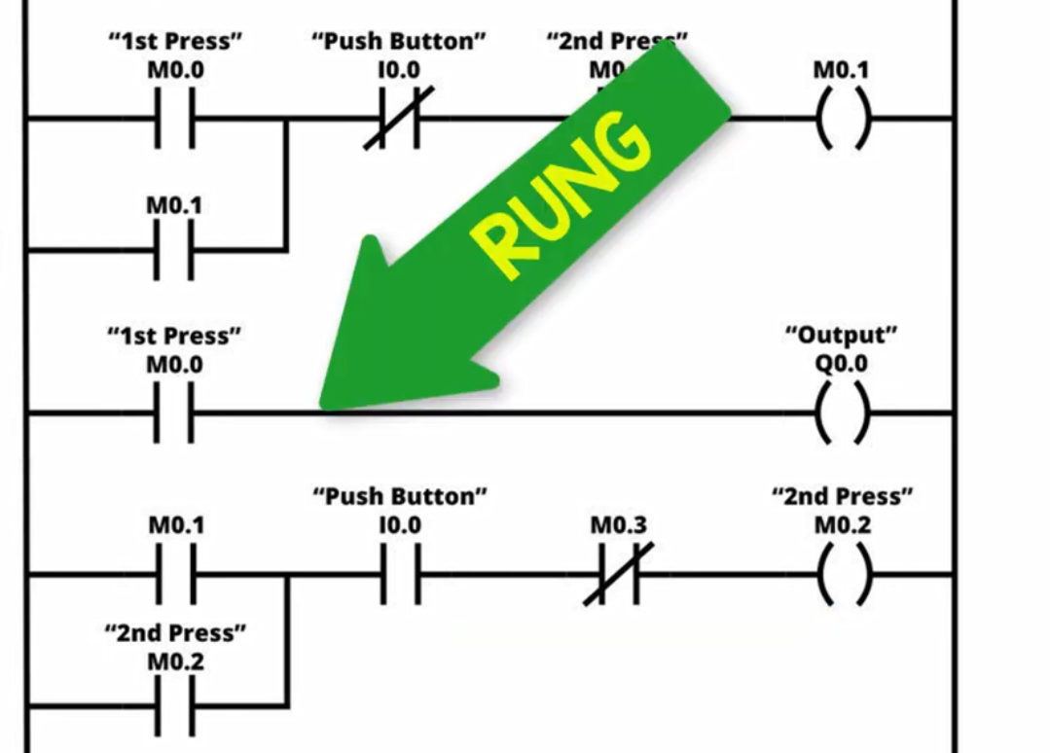

Slide 20
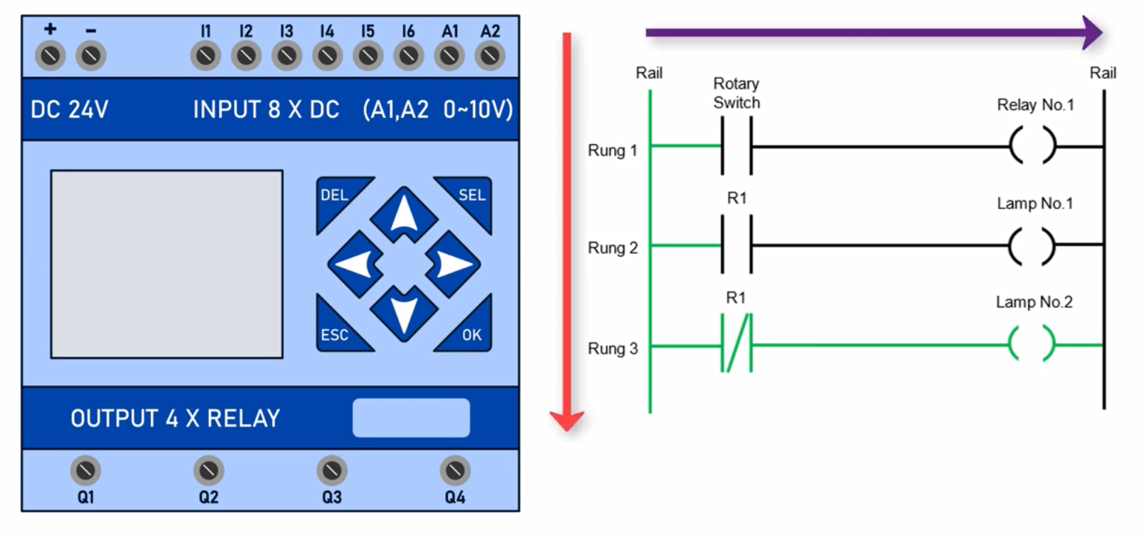

Slide 21
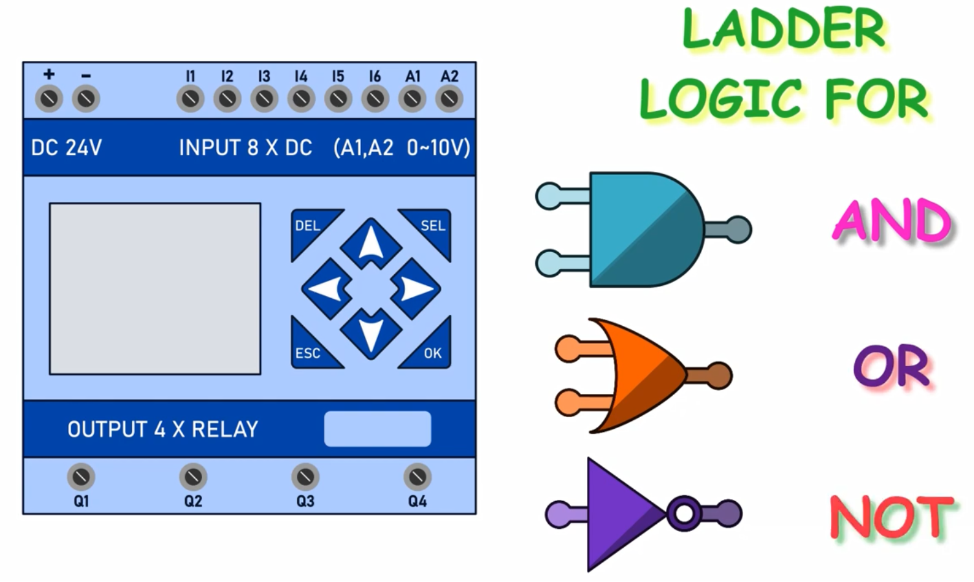

Slide 22
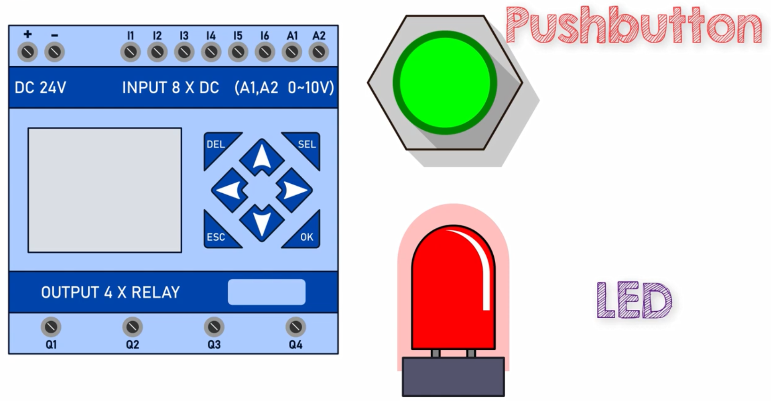

Slide 23
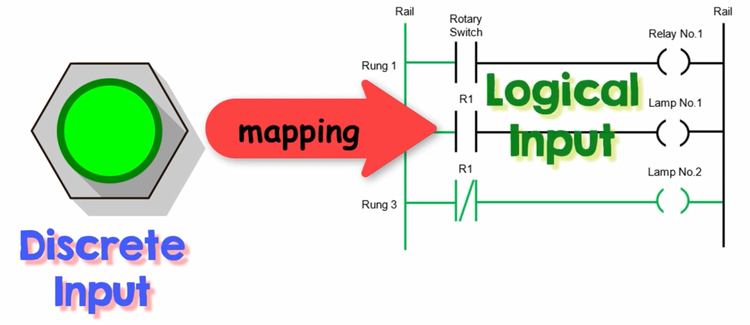

Slide 24
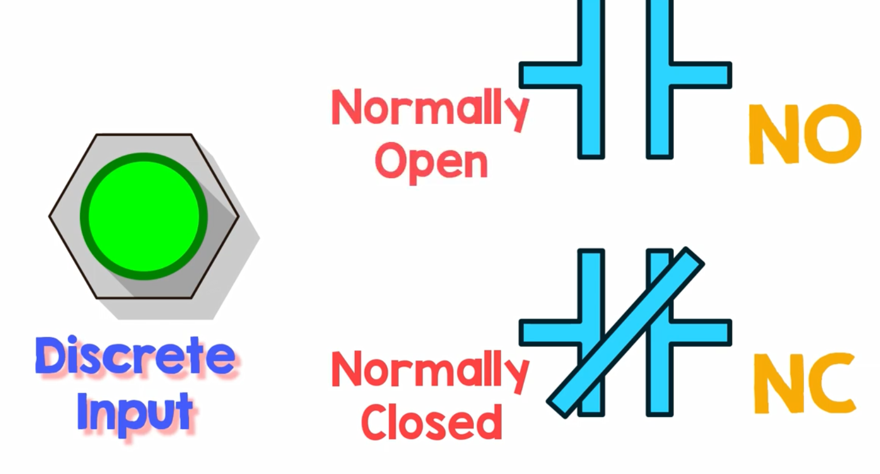

Slide 25
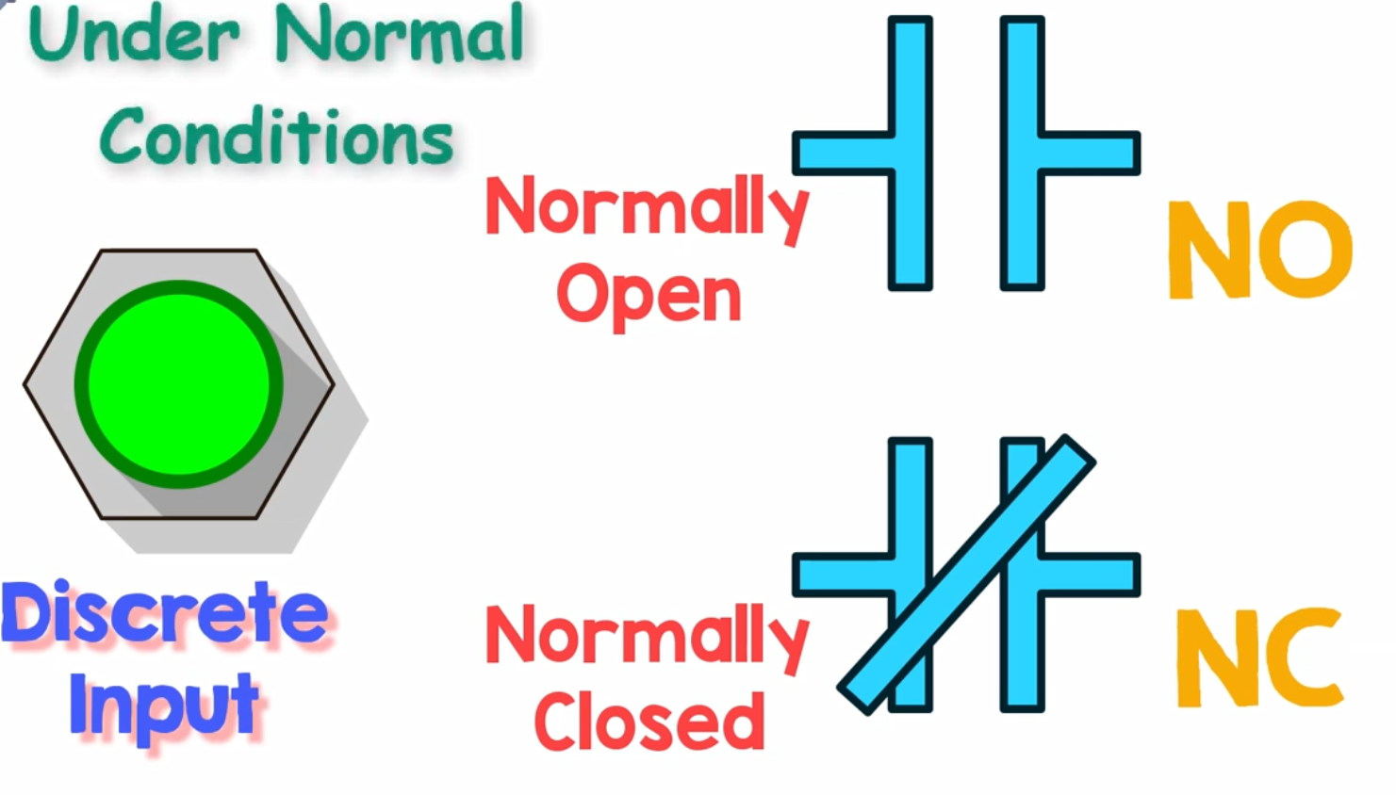

Slide 26
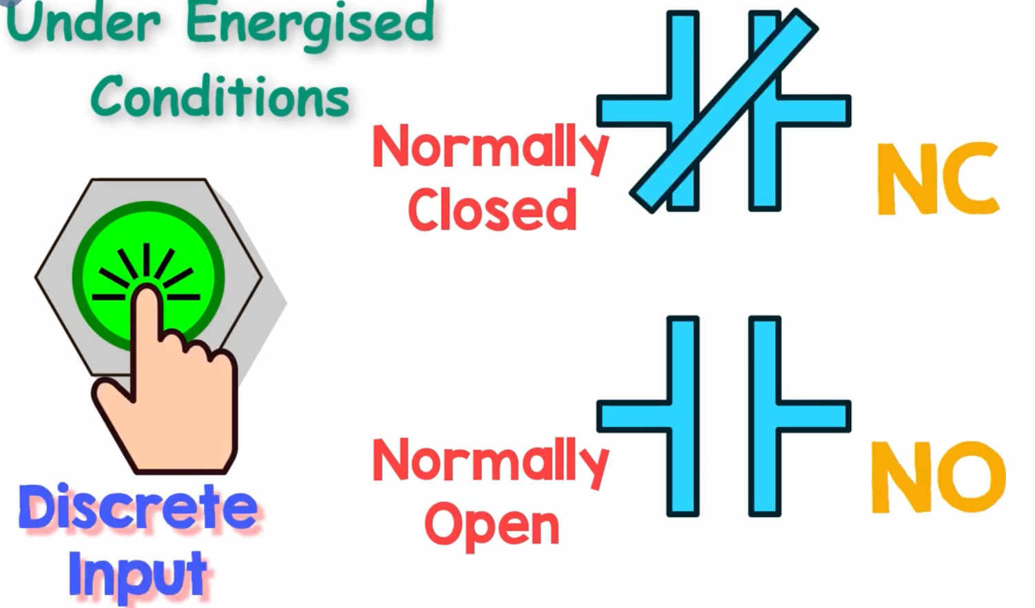

Slide 27
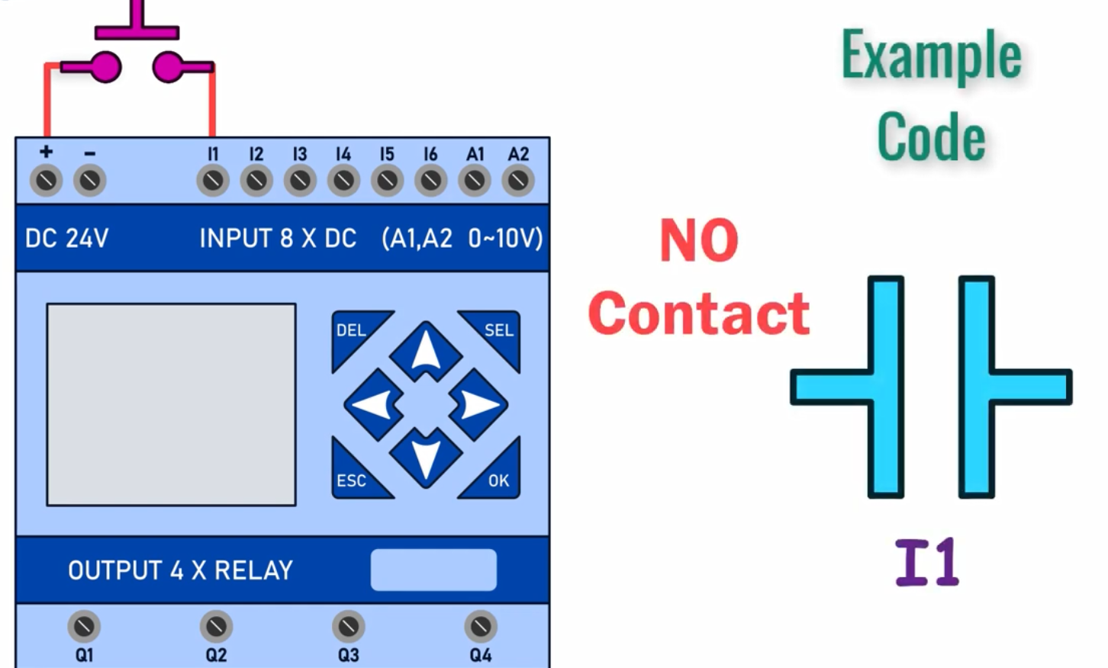

Slide 28

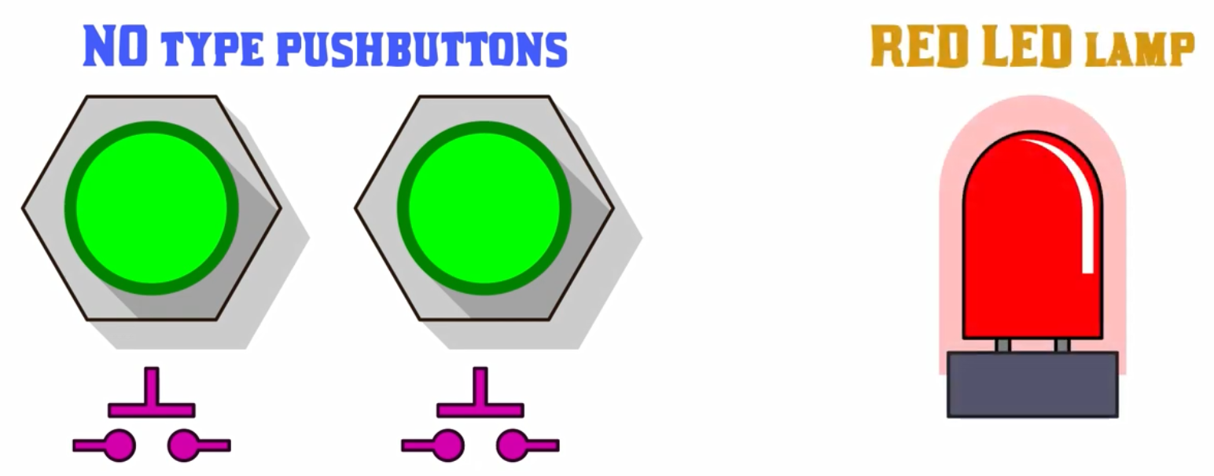

Slide 29
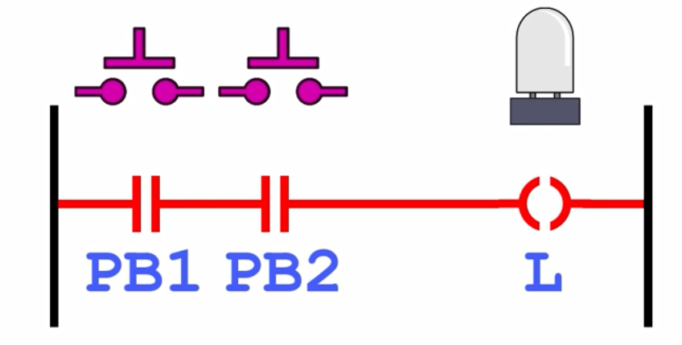

Slide 30
